Slide 1


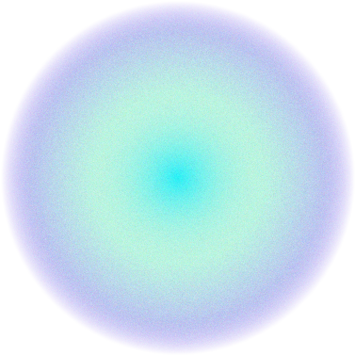
Lego Football Control
Claudio, Freddie

Slide 2
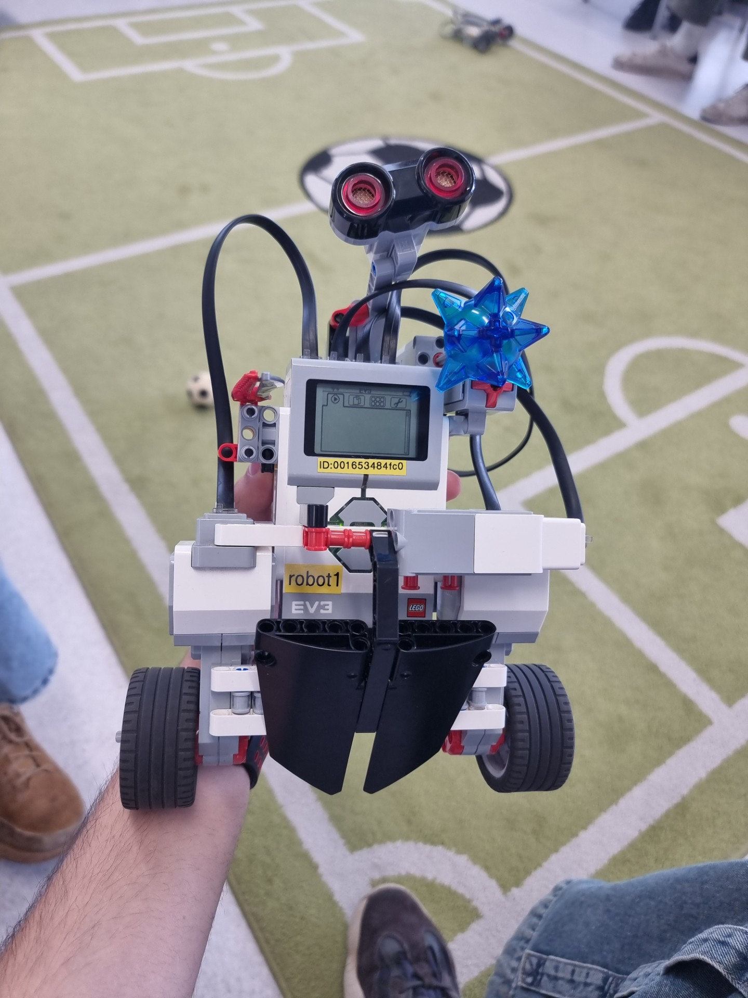
Introduction
Over the course of the past week, we have developed a control system for a multiple input – multiple output (MIMO) analysis of the Lego Mindstorm EV3 robot. To achieve stability and some performance requirements, we have independently designed a single input – single output (SISO) closed-loop system for each variable (namely x1 = [θ; ψ; θ˙; ψ˙] and x2 = [φ; φ˙]), where these angles represent:
· θ = common mode rotational angle of left and right wheel
· ψ = pitch angle of the body with respect to the vertical
· φ = yaw angle
We obtained a linearised approximation of the system’s dynamics and applied two different approaches in order to determine our controller gains. The first involved the use of a root locus plot and the second direct pole placement. We then tested our control system on the hardware, implementing a gamepad to control the robot’s movement.
Finalised assembly of Arjen Robbot

Slide 3
01.
Mathematical Framework
Q1-7

Slide 4
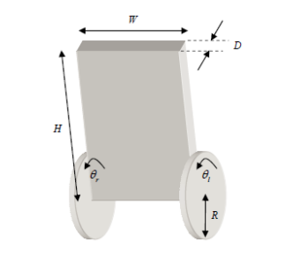
Mathematical Model
We started our analysis by deriving a mathematical representation of the system’s state space. Due to the presence of several non-linear terms in the governing equations, we linearised the dynamics about a pitch angle ψ of 0 degrees (vertically upwards), yaw and common mode angles φ and θ of 0, pitch, yaw and common mode velocities ψ˙, φ˙, θ˙ of 0.
Physically, this meant our model’s validity relied on the assumption that the robot would stand vertically upright during operation. This placed some limitations on the range of attitudes our robot could achieve whilst being stable, as the model would not work outside of the pre-established domain (small ψ perturbations away from equilibrium).
Calculations for the state space dynamics are detailed below

Slide 5
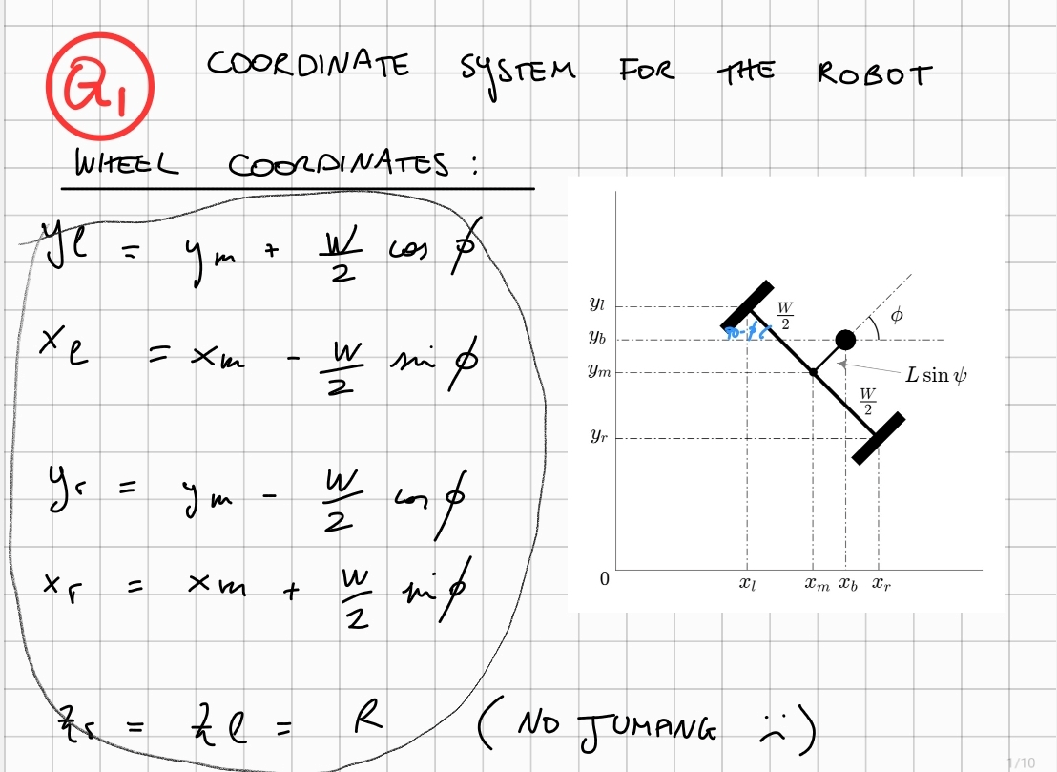
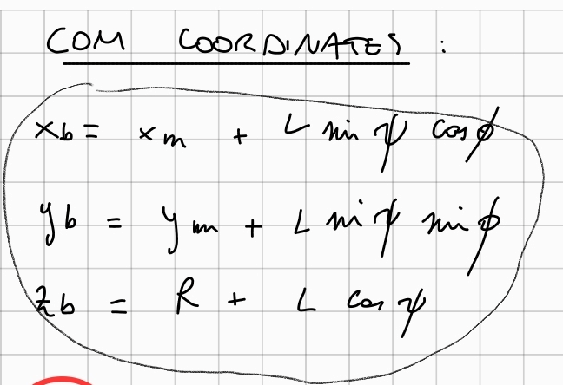
Question 1
Developed a global coordinate system for the robot’s body and wheels

Slide 6
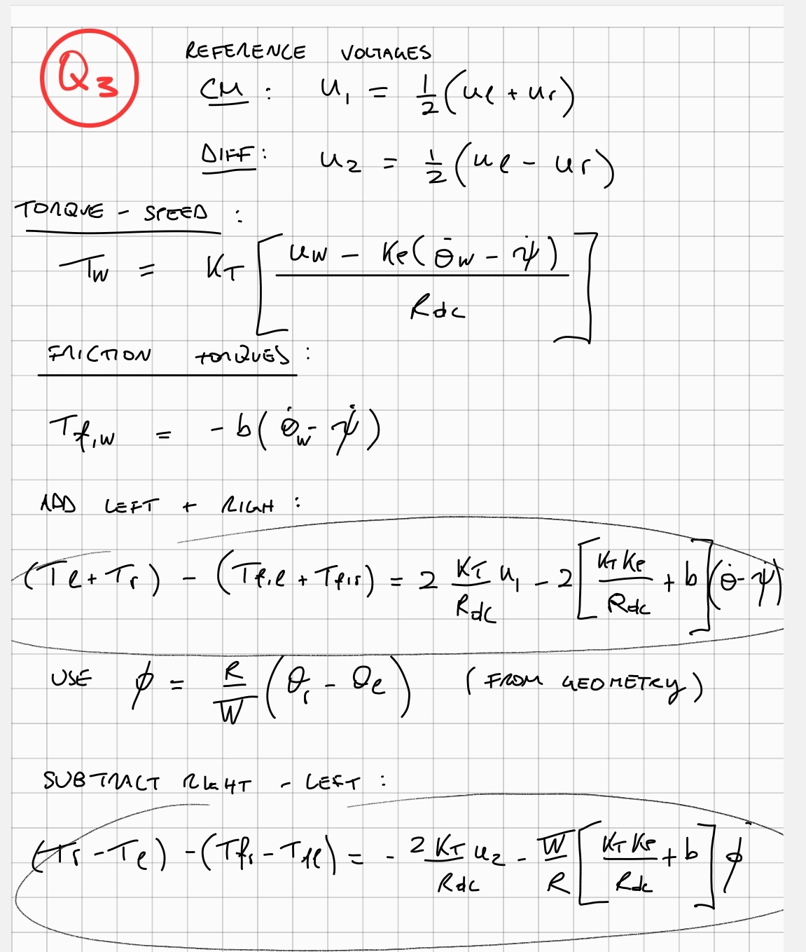
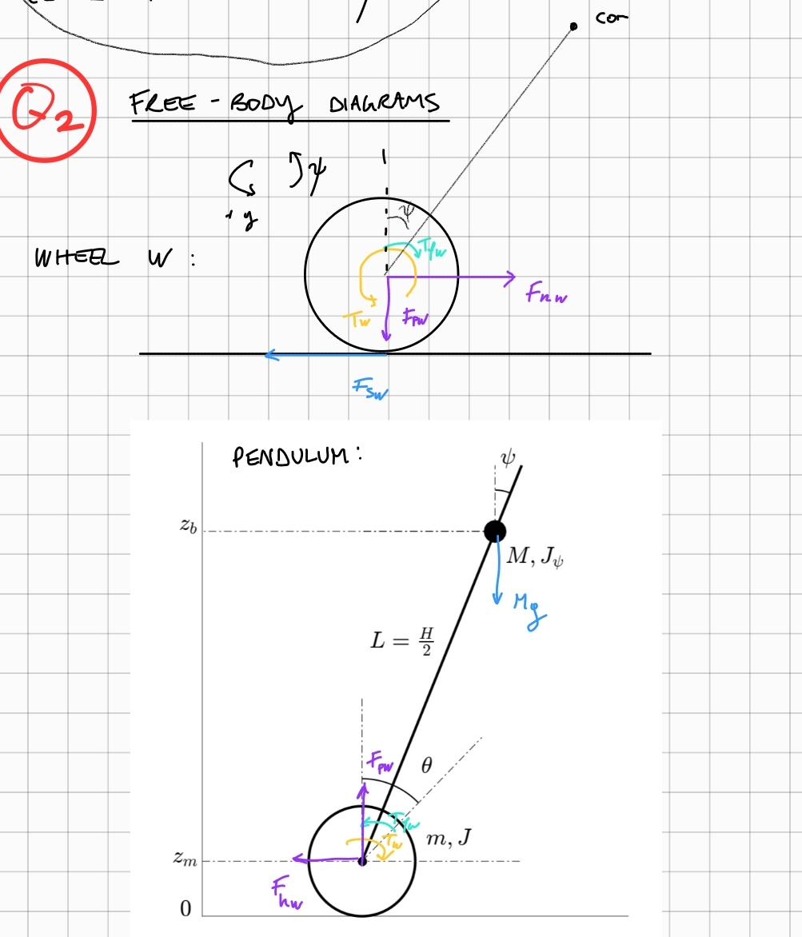
Questions 2-3

Slide 7
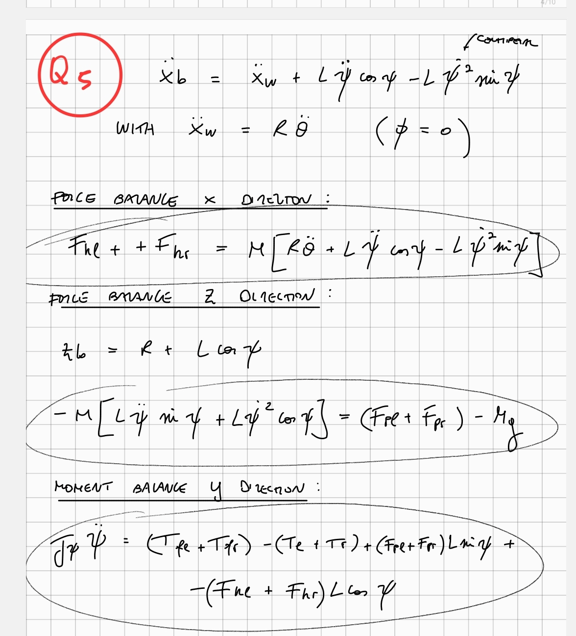
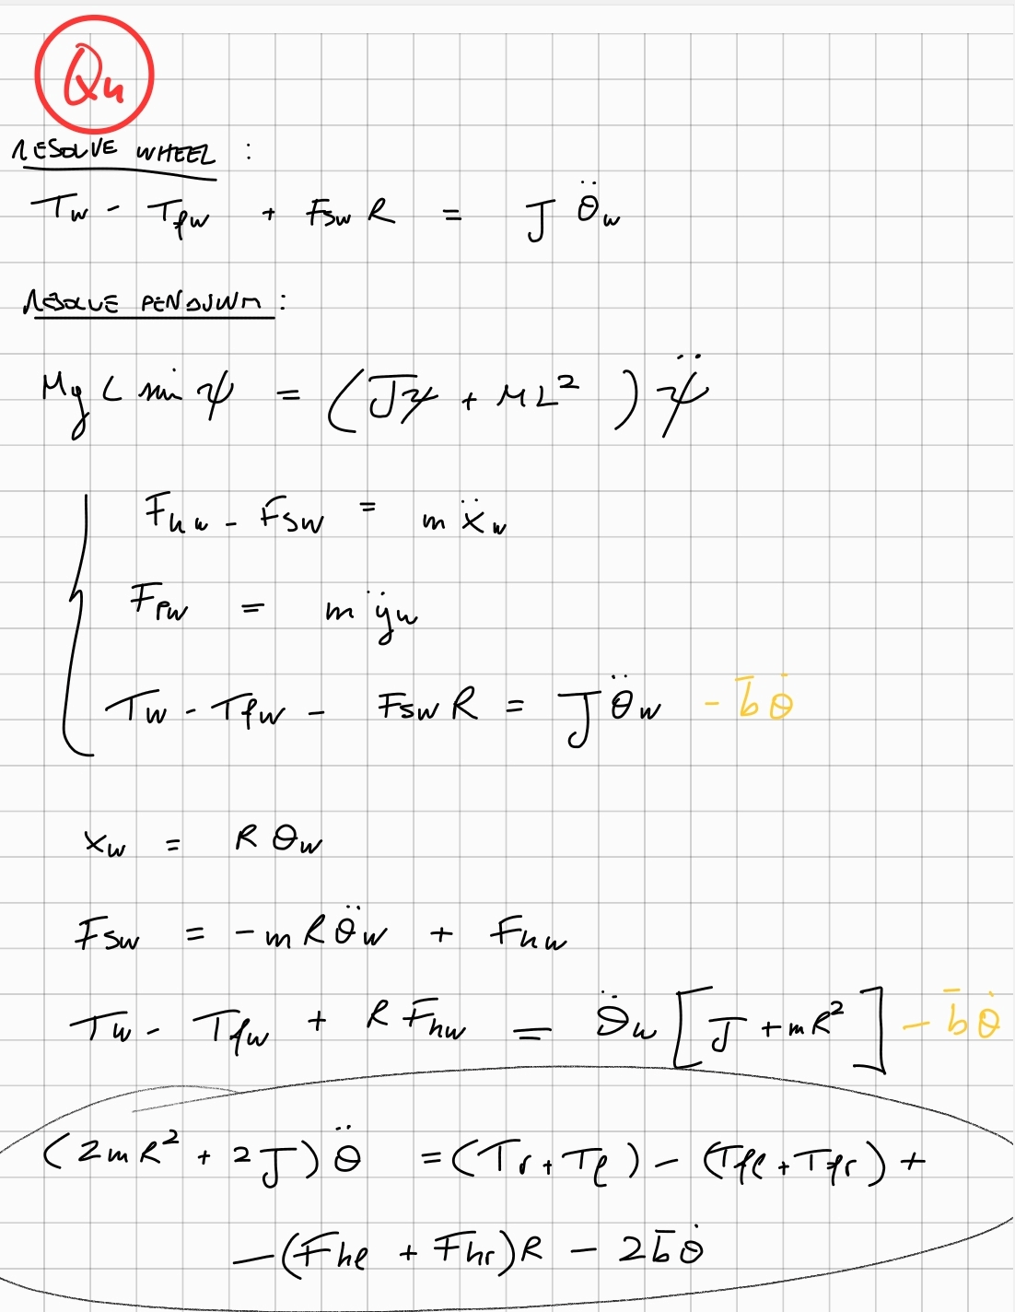
Questions 4-5
Using the free-body diagrams, we derived the governing equations

Slide 8
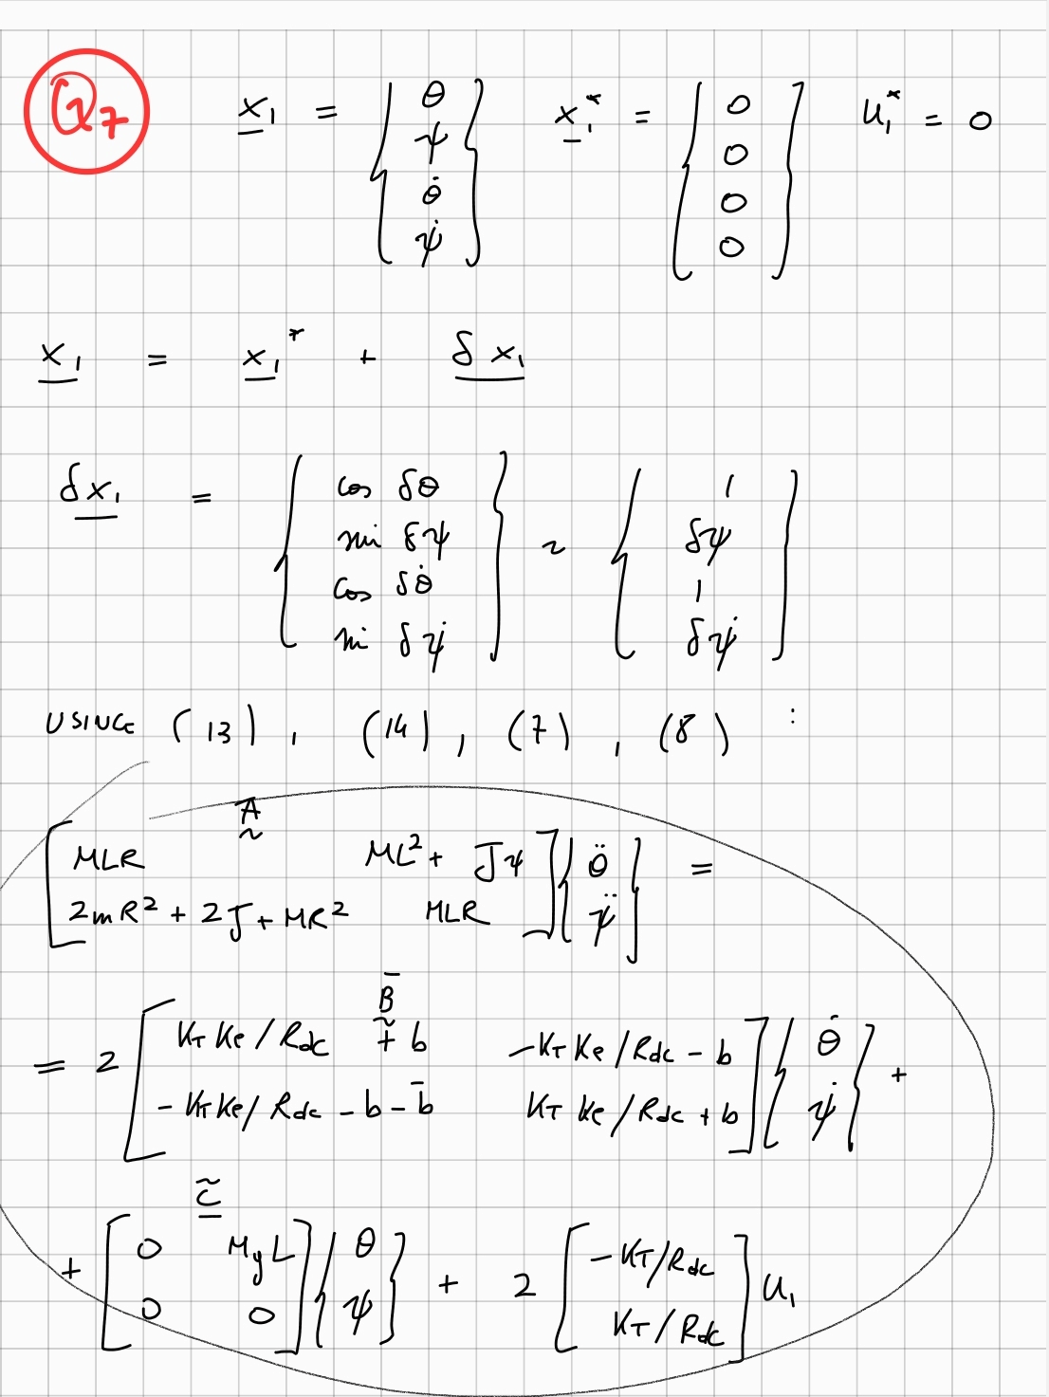
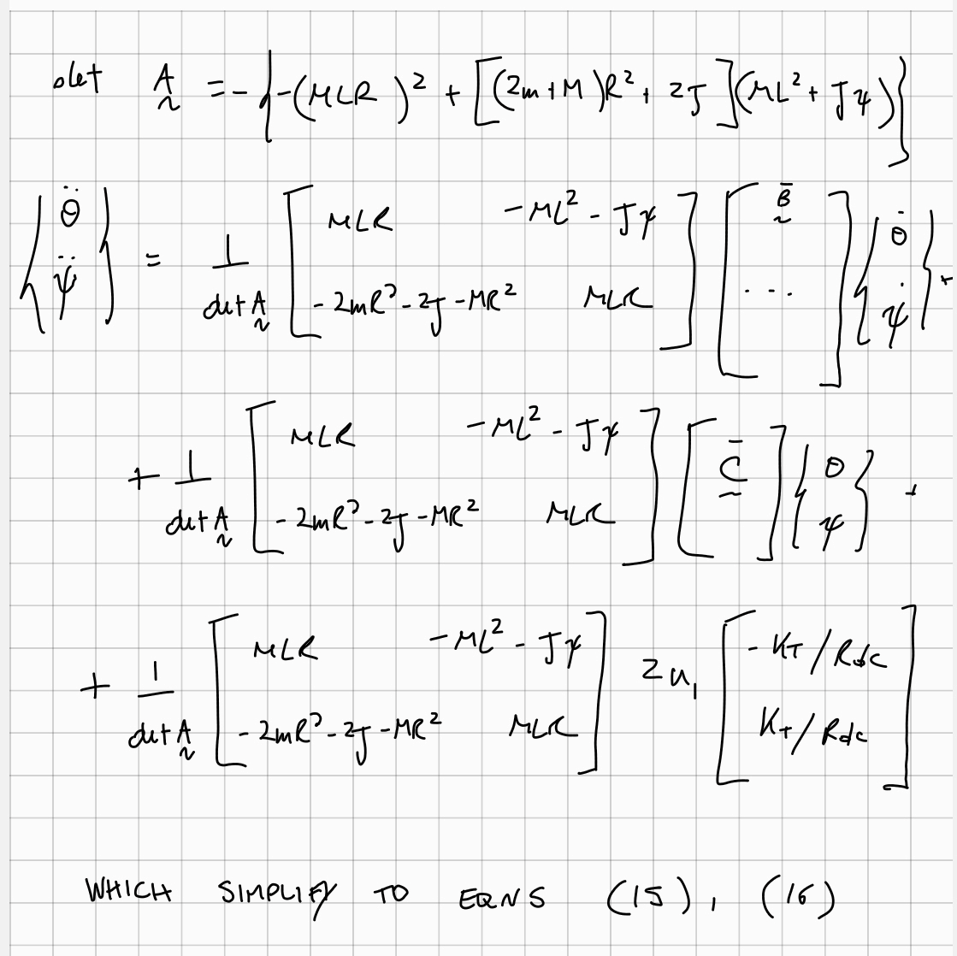
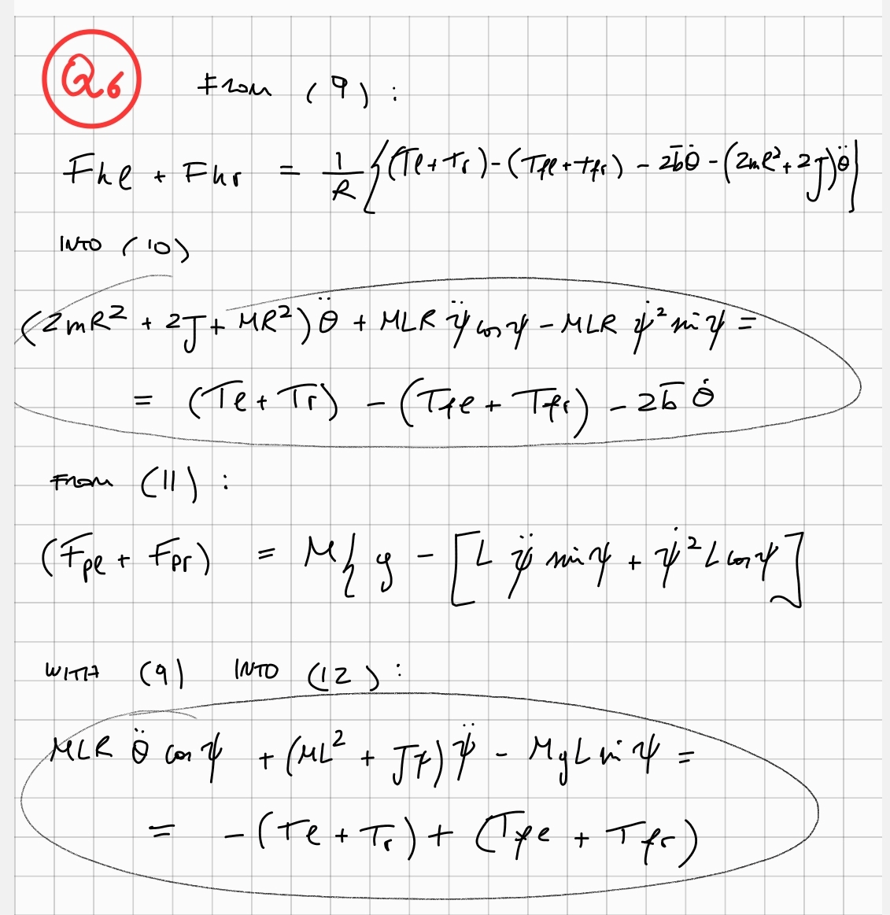
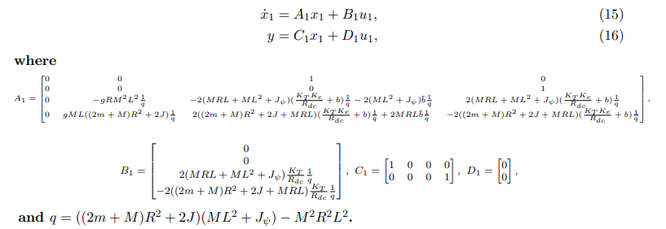
Questions 6-7

Slide 9
02.
Controller Design
Q8-20

Slide 10

Controller Design
It was decided to design 3 controllers for the system; one for each angle
This is because it is simpler to create and tune a SISO controller than a 3 input 3 output controller, which is beyond the scope of this module
The system involving psi and theta was assumed to be independent of the system with phi, since the yaw is controlled entirely by the differential motor voltages, whereas the pitch and forward motion are the common mode motor voltages

Slide 11
Pitch Controller
The first step of our controller design is making the model into transfer functions.
Using MATLAB commands ss and zpk, the state space model developed earlier was converted to a series of transfer functions
We first worked on the system describing phi and theta

Slide 12
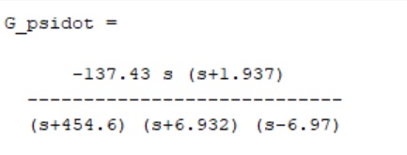
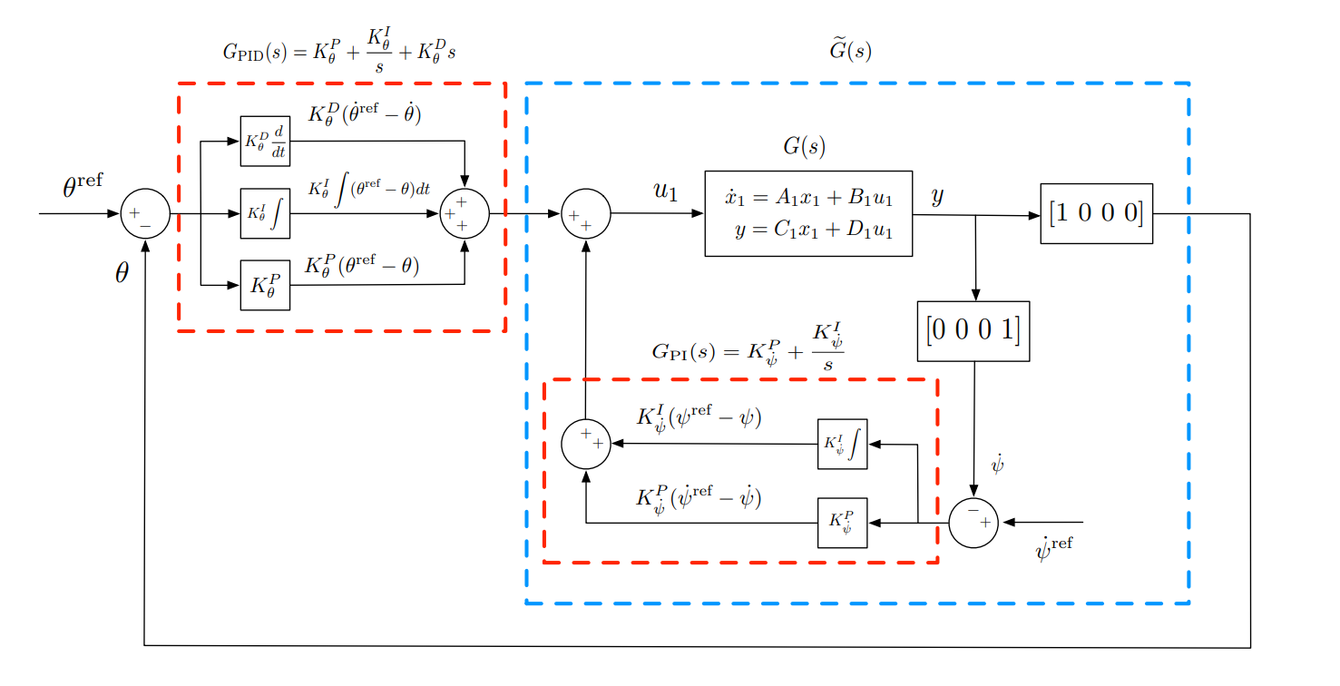
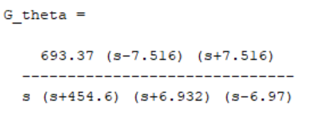
Pitch Controller
The transfer functions relating u1 to theta and psi dot were both unstable, as they contained positive real poles
Pitch and theta control system structure
Transfer functions

Slide 13
Pitch Controller
Therefore, we had to add a controller to the system. To begin, we focused on controlling the pitch of the robot, as that allows it to stand up and be stable (the most important function, and necessary to test anything else)
The gyroscope on the robot is only able to measure the rate of change of angle, which suggested the use of a PI controller for psi dot

Slide 14
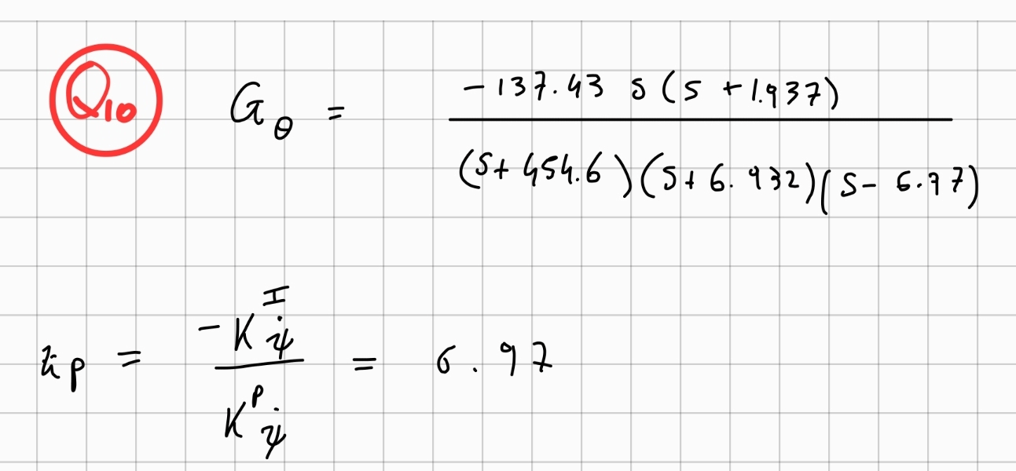
Pitch Controller
In MATLAB, we defined the transfer function of a PI controller, and multiplied this by the system transfer function
There were two free variables to be chosen: the proportional gain and the derivative gain
Therefore, to fix one of these variables, we had to choose an appropriate zero (ratio between gains) that we desired in the open loop transfer function

Slide 15
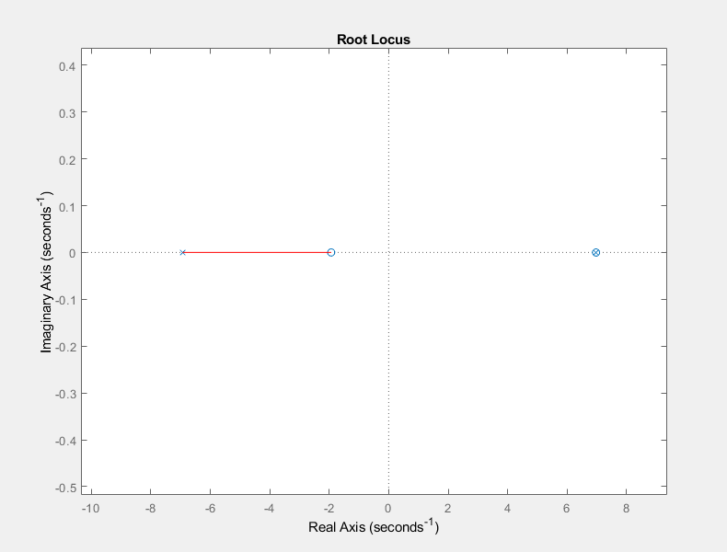
Pitch Controller
Initially, we chose this zero to be at +6.97, to attempt to cancel the effect of the unstable pole
However, when we plotted the root locus with this zero, it became clear that it would 'block' the unstable pole from becoming stable
This is because, as the total gain increases, the closed loop poles of the system shift from the open loop poles to open loop zeros. We also understood how this pole came from model parameters, which are subject to imperfections and tolerances. Hence the RHP pole could never have been precisely canceled with a RHP zero

Slide 16
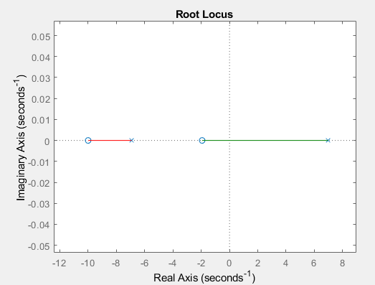
Pitch Controller
We then made the zero negative
There was a trade-off between how large the zero was and the gain required to make the system stable
The compromise that we settled on was gains of –10, and –100, with a zero placed at -10

Slide 17
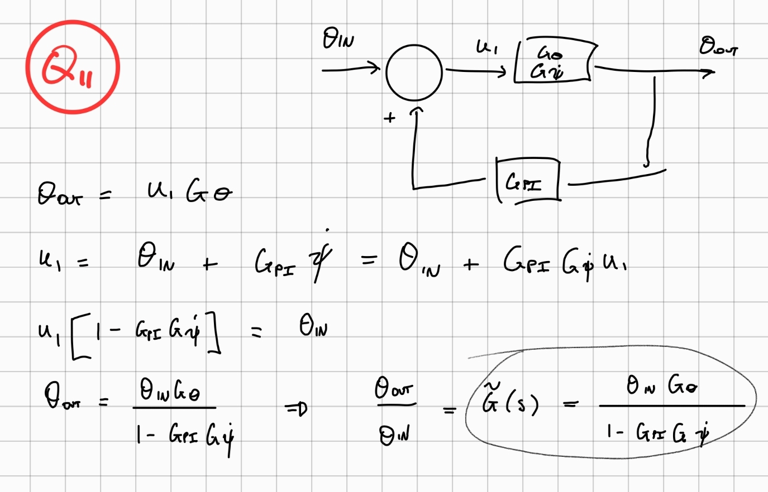
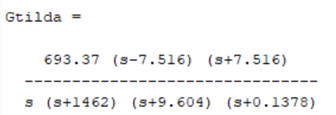
Theta Controller
The theta controller could now be designed. It had to account for the effect of the pitch controller, therefore its system transfer function was re-calculated as Gtilda, including the feedback loop of the pitch controller
The theta controller was specified to be a PID controller, satisfying the conditions of a 50 degree phase margin, and 10 second settling time

Slide 18
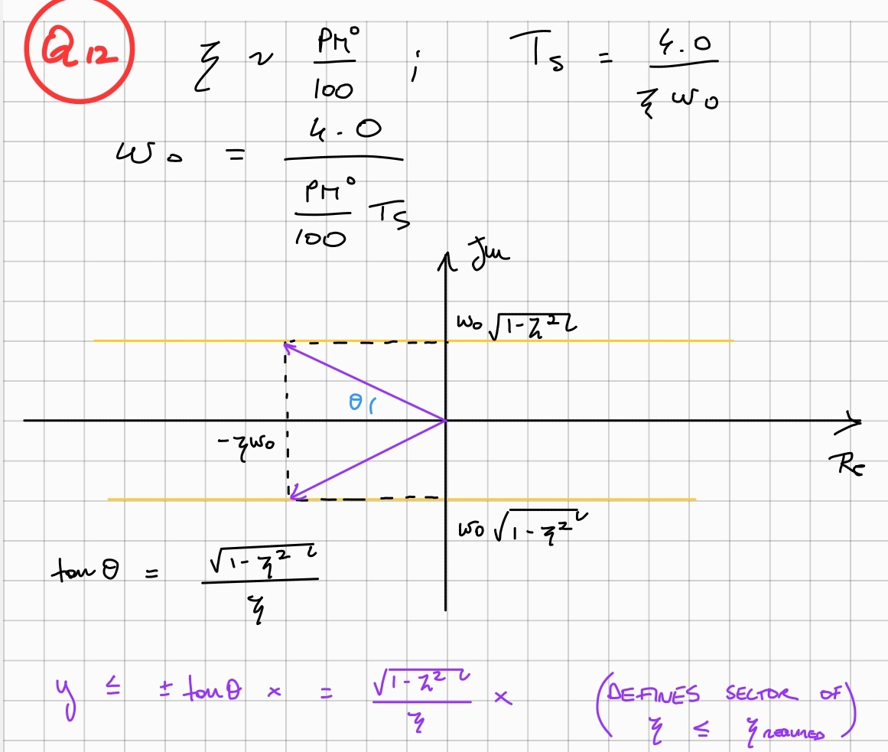
Theta Controller
To achieve these specifications, we aimed to add a dominant second-order pole pair to the system using the PID controller, which achieved a given natural frequency and damping factor
We used the approximations of Zeta ≈ PM°/100 and w_0 ≈ 4.0/(Ts x Zeta) to determine values to aim for
We then compared the PID controller to standard form, and determined the pole positions required to achieve these specifications (-0.46 +- 0.797i)

Slide 19
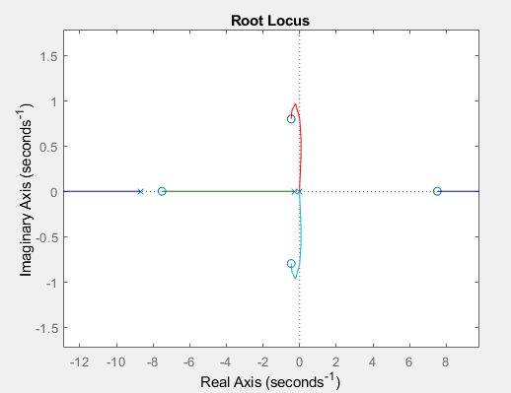
Theta Controller
These poles were set as zeros of the transfer function, which when multiplied by Gtilda gave a root locus plot
From this plot we chose a gain required to stabilise the system
However, as this was not a perfect second-order system, it didn't quite achieve the design specifications
By slowly adjusting the gain, we ended on a set of gains which achieved the required settling time and phase margin (using MATLAB functions to check)

Slide 20
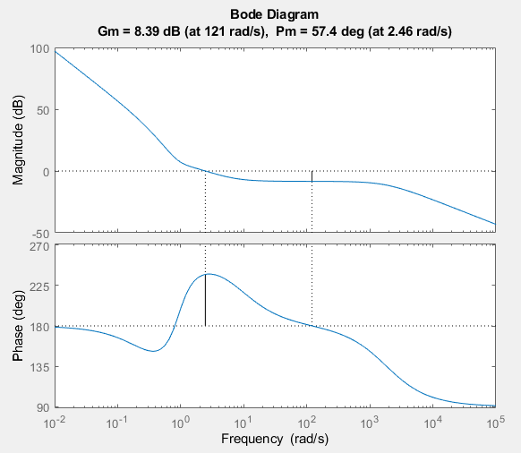
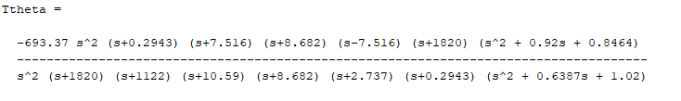
Theta Controller
We checked the whole system's stability using a bode plot, which showed it had a suitable phase margin, and looking at the poles of its closed loop transfer function

Slide 21
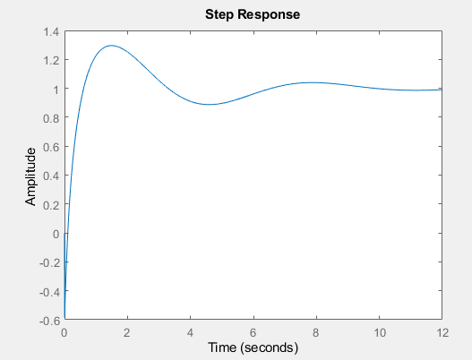
Theta Controller
We also checked the step response of the system.
It had a distinctive kick down at the start, no matter what gains were chosen.
This is due to the positive zero in the system's transfer function, and it could not be removed, only minimised by taking appropriately low gains

Slide 22
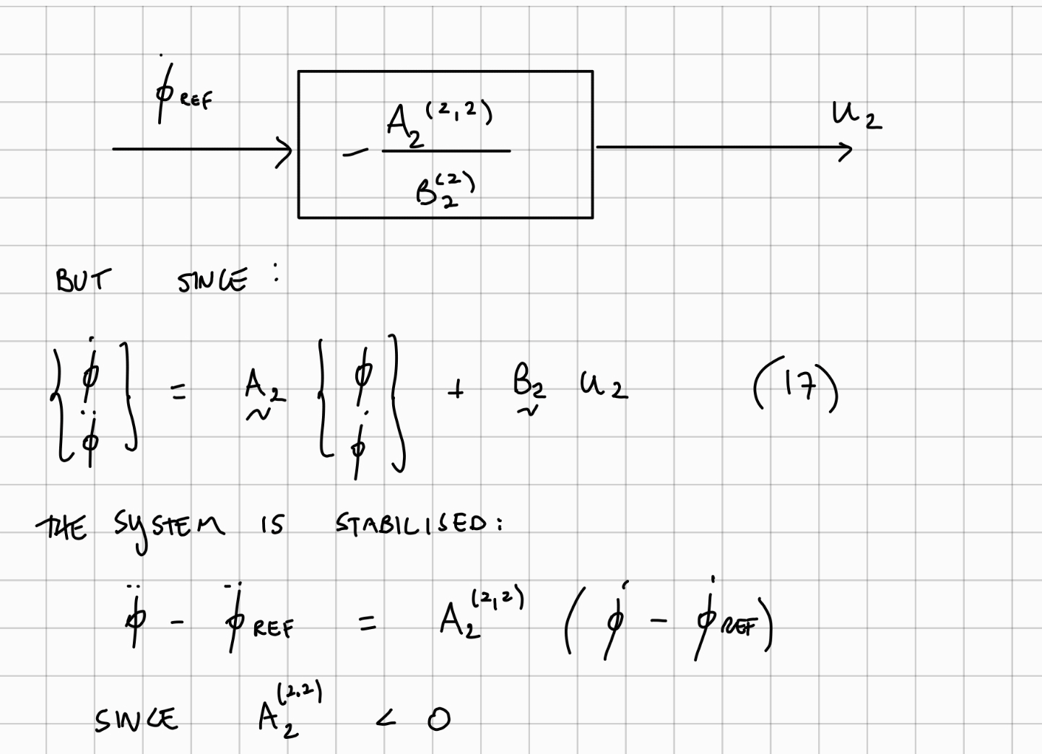
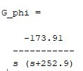
Yaw Controller
The yaw system is simpler, and can be controlled by just a proportional controller
There were two possible options: a closed loop or open loop control system
First, we used the state space system to calculate an open loop gain which would be able to track the input.

Slide 23
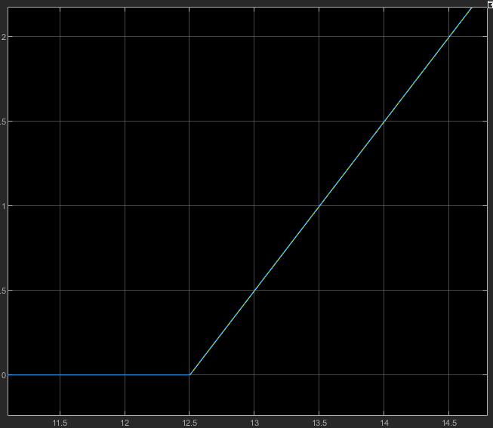
Yaw Controller
This open loop controller worked perfectly in Simulink
However, if applied to the real robot, it would inevitably veer off course due to model imperfections.
We verified this by scoping the yaw angle against its reference: the two signals were parallel but there was a constant offset between them, which kept drifting and increasing as time passed
Yaw open loop ontrol system tracking a unit ramp

Slide 24
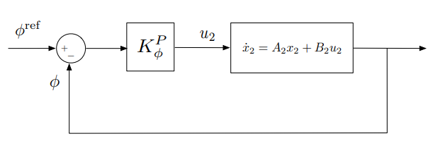
Yaw Controller
The closed loop controller was designed as a proportional controller, where any gain would make the system stable
Through trial and error in Simulink, we settled on 6 as a gain which would provide a fast response, without exceeding the maximum possible actuator inputs
Yaw closed-loop control system structure

Slide 25
03.
Hardware Tuning
Q21-24

Slide 26
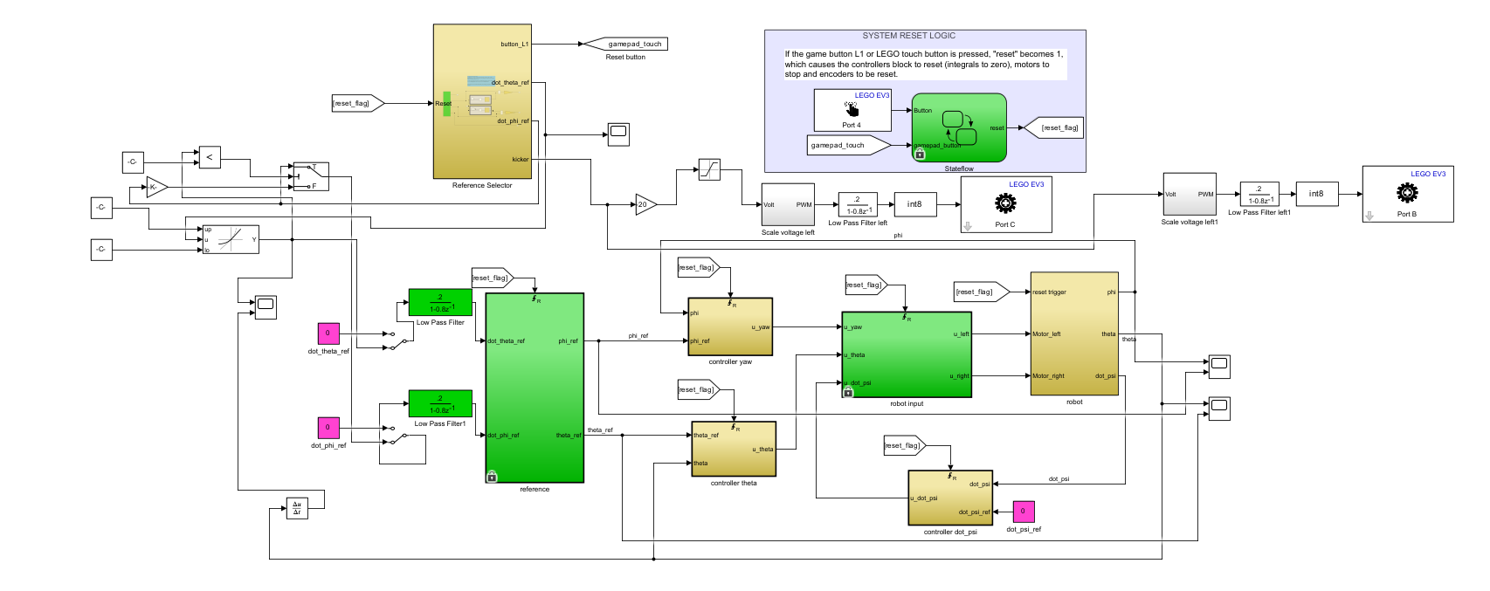
Hardware Implementation
To implement our theoretical control system model onto the physical robot, we modified a new SIMULINK file
We added algebraic relations, the values of all of our gains, and some EV3-compatible blocks in order to interface with the Mindstorm.
We also switched from continuous-time to discrete-time, as all the transducers and actuators were digital.
We were initially able to get our robot to stand upright solely on the effects of our control system. However, it was clear that tracking a reference would have required some additional control...
Our finalised control system

Slide 27
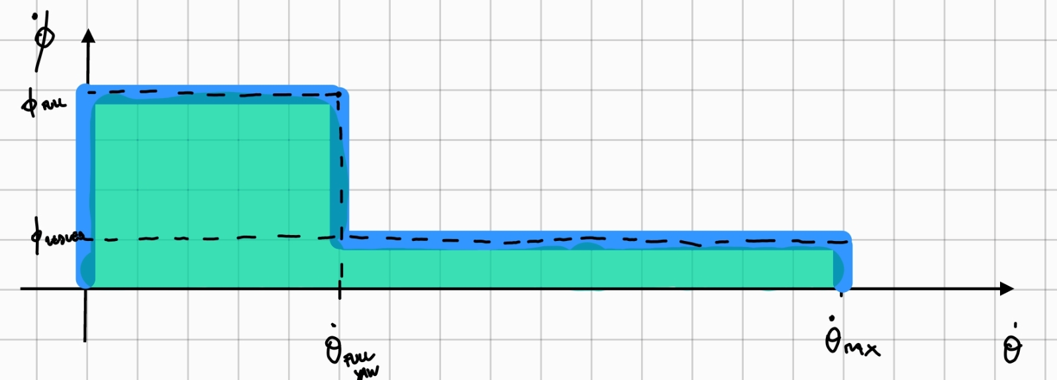
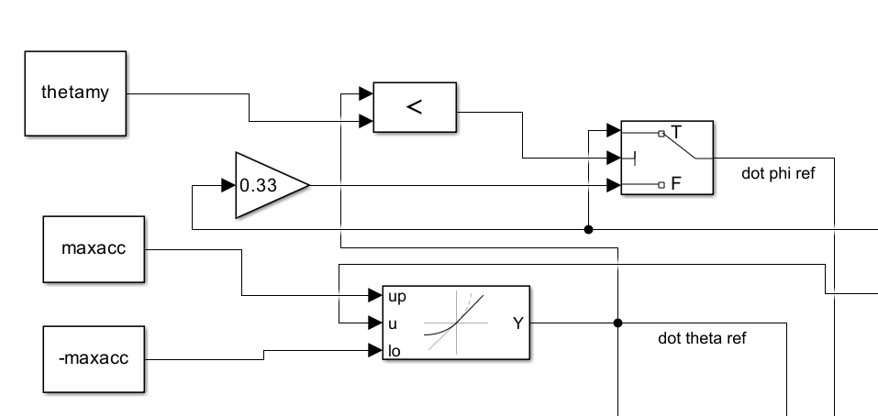
Hardware Implementation
The robot had a maximum allowable acceleration θ˙˙and speed θ˙ it could experience before losing stability. We discovered this by investigating the time derivatives of the theta signal
To resolve this issue, we implemented simple limiters to give upper bounds to θ˙ and θ˙˙. We also added low pass filters to our references to further smooth sharp accelerations, as this helped our robot be stable for more complex inputs.
We then realised the most common cause of control failure was when forward/backwards motion and yaw were happening simultaneously, so we introduced a limit on φ˙ based on the state of θ˙, as per the illustration
Scheme used to prevent combined mode instability
SIMULINK Implementation

Slide 28
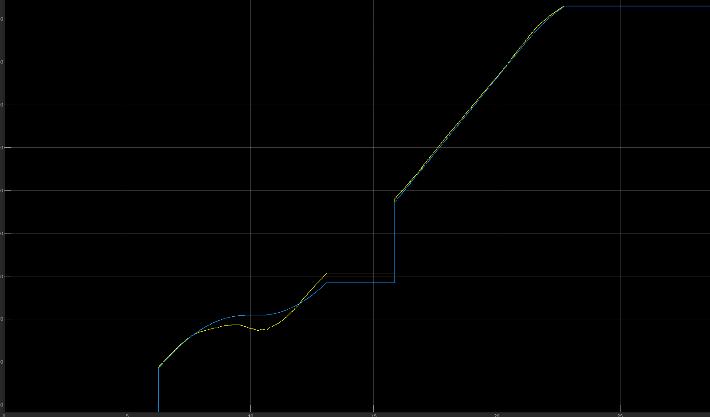
Hardware Implementation
We also tested both the open loop and closed loop yaw controllers in hardware. As expected, the open loop system could not track signals well due to a lack of feedback. The feedback is neccessary as the model is not absolutely perfect. There are disturbances, and model limitations that mean that feedback is required to accurately track a signal
The graph shows the robot's tracking of theta inputs. The reference signal is clearly tracked very well.
The limited slope is due to the limit placed on acceleration (the jerk of this graph), as that was causing the robot to fall over
It can also been seen in the graph that the tracking is less good in the wobble in the middle, where the robot was also yawing. This is why we introduced the cap on yawing speed when the robot was moving

Slide 29
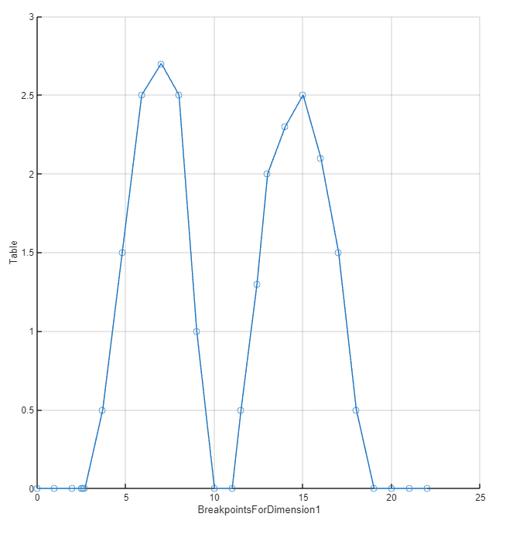
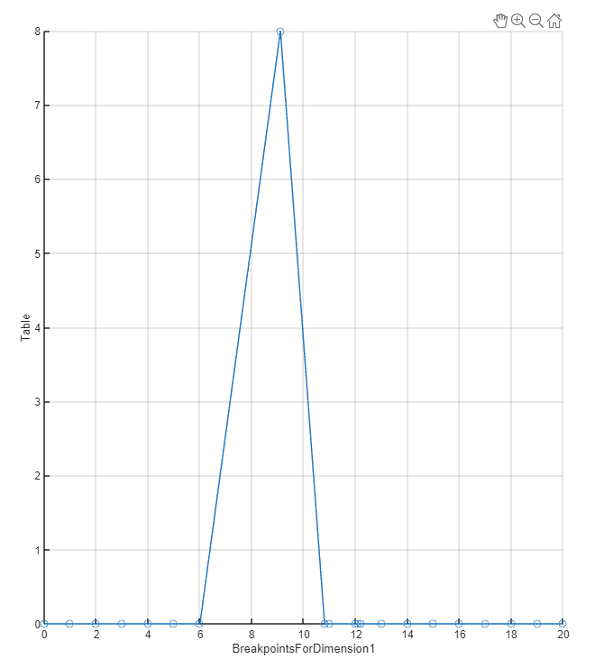
Halfway Line Manouver
The initial reference tracking of the robot was performed fully autonomously, with the task of performing a 180° to and from the halfway line. After some tuning, we finalised our input for θ˙ and φ˙ as shown below, using cubic splines for the smoothing of the former, and hold for the yaw signal such that it was a pulse input
Theta reference signal
Yaw reference signal

Slide 30
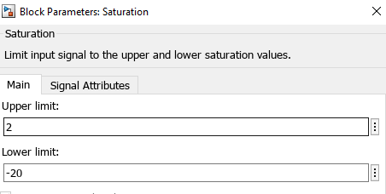
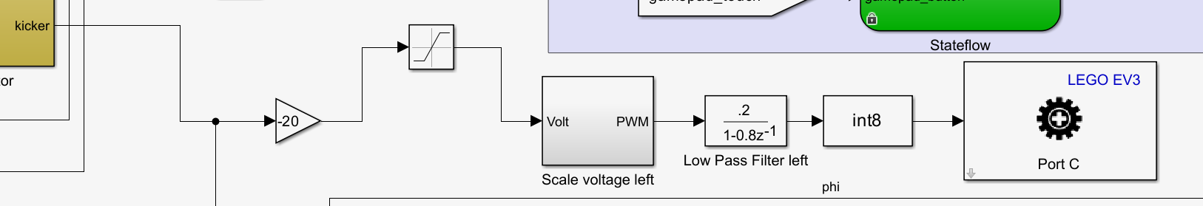
Gamepad + Kicker Implementation
We introduced a secondary SIMULINK script to run the gamepad, and wirelessly connect it to the robot, so it could provide the reference values θ˙ and φ˙ for the robot to track. This involved the addition of two new gains, which we tuned to obtain a reasonable response to our inputs.
Since the purpose of the robot was to play football, we introcuced a third motor mechanically connected to a kicker blade. We tuned the kicker gains so the blade would swing very quickly on the upwards stroke (for improved shot power), but then returned to its rest position slowly (for improved stability)
Scheme used to provide voltage to the kicker motor

Slide 31
04.
Pole Placement and Final Touches
Q25-28

Slide 32
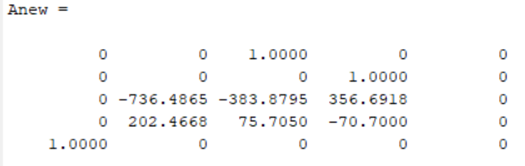
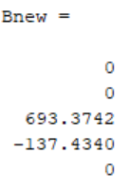
Pole Placement Method
As an alternative method to the use of a root locus diagram to identify the controller gains, we adopted a direct pole placement strategy, which involved:
Computing the target characteristic polynomial (whose roots are p1, . . . , p5). This is given by Π_{i=1}⁵ (s − p_{i}).
Computing the characteristic polynomial associated with the augmented system matrices Anew and Bnew
Equating coefficients between the two polynomials
This is however performed under the hood by the MATLAB function place(Anew,Bnew,P), where the user has to provide the vector of poles P

Slide 33
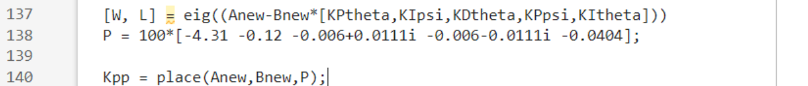
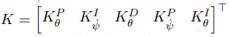
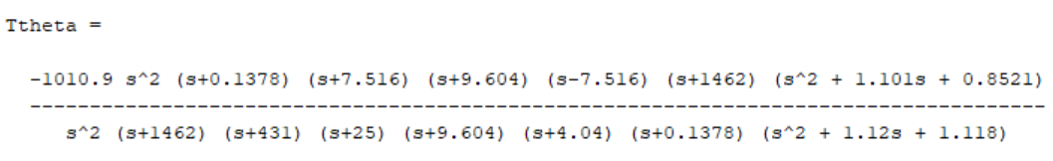
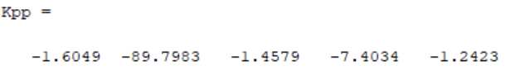
Finalised Design
We initially checked the validity of the new method by confirming inputting the position of our current poles would result in the same set of gains we had previously chosen
After some feedback-driven fine-tuning, we eventually landed on our best-performing controller by selecting the shown pole locations, with gains and transfer function:
This model gave the best stability when driving the robot, and met all of the performance requirements as illustrated on the next slide

Slide 34
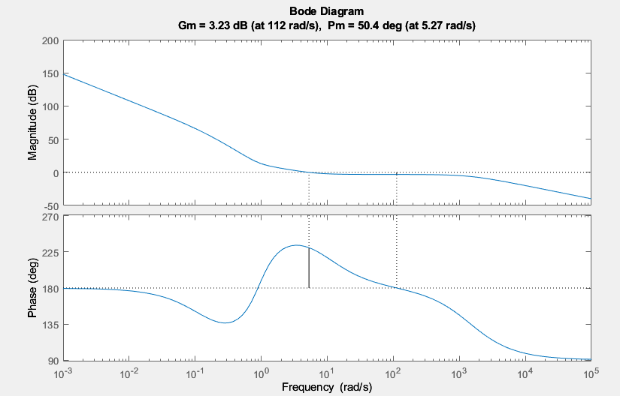
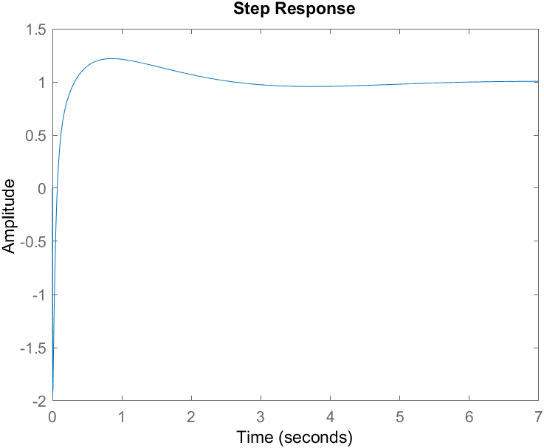
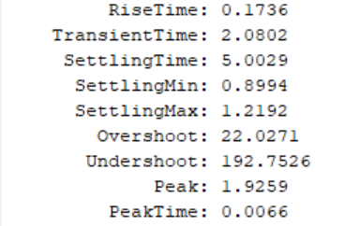
Finalised Design
Our Phase margin was just above 50°, and our settling time was almost half of that of the requirement (5s compared to the required 10s). Closed-loop stability was also achieved

Slide 35
Pole Placement vs Root Locus
In the end, our control system worked much better with the final pole placement control system.
However, it was only when we realised to start with our poles from our first method and adjust from there, rather than starting from scratch, that this was achieved.
The root locus method allows you to understand how the system is changed by gains as you design them, and each gain can be individually tuned, whereas in pole placement the gains can all change as you change pole positions.
Pole placement allowed us to precisely place the poles where we wanted them, rather than using an iterative trial and error method on root locus diagrams. This allowed us to eventually reach a better controller, that had a more dominant second order response.
Both techniques are limited by the model's imperfections, especially the changing mass as the robot acquired a kicker, and a better technique would also involve improving the model

Slide 36
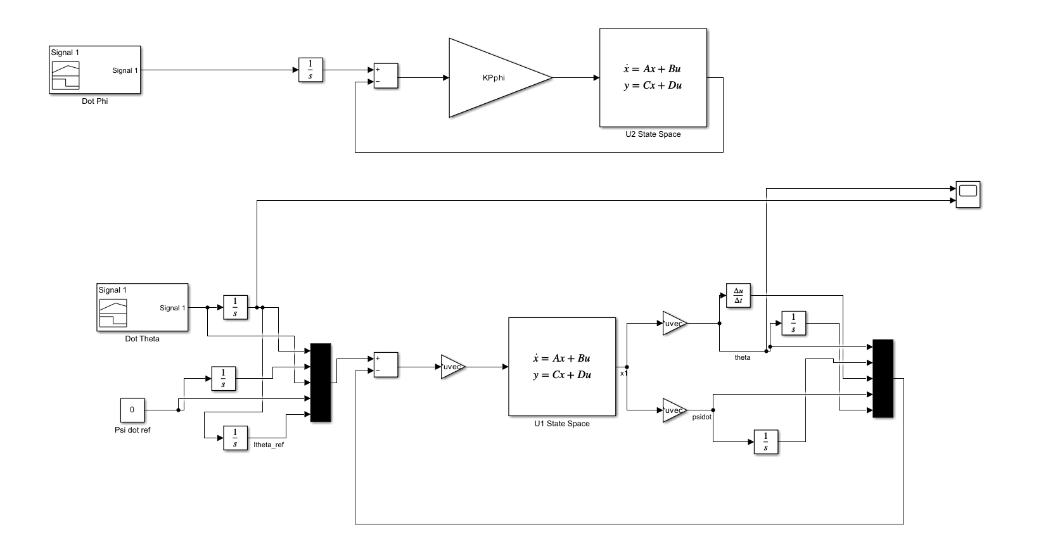
Simplified SIMULINK Model
As our final stepped, we created a modified SIMULINK model of the finalised design. This was done in order to better be able to visualise the two independent closed-loop systems involved. We made sure that the signals available matched those of the physical system (namely, rate of change of pitch angle ψ˙ , yaw angle φ and θ).

